Slide 1
Presenter name and degree here
Your organization here
Date of presentation
Name of meeting

Slide 2
PLACE fieldwork
Level 1: Community informant interviews
Level 2: Venue informant interviews and mapping
Level 3: Patron and worker interviews and HIV testing
Notes:
We have already gone over the first level of PLACE field work, identifying venues through community informant interviews. Now, we will talk about Level 2: visiting the venues to interview someone who knows about the place and mapping the venues

Slide 3
Purpose of venue informant interviews
Does the venue exist?
Collect information about:
Venue characteristics
People who visit
HIV prevention programs on site
Notes:
The first question venue visits answer is, does the venue exist or not? And if it exists, is it in operation?
The primary purpose of the venue visit is to collect information about the venue, such as:
Characteristics – what type of venue is it? What do people do when they are there? What are busy days and times? Are condoms available for sale or for free on site?
Clients or patrons – who comes to the venue? Youth? Mostly men? Sex workers? How many people at a busy time?
HIV prevention – has there been any HIV prevention effort at the venue? Condom distribution? Peer education? HIV testing?

Slide 4
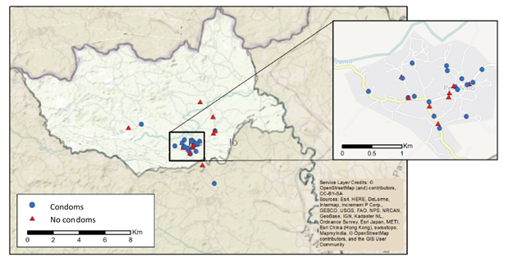
Purpose of mapping venues
Create maps useful to programs
Notes:
A key part of PLACE is mapping the venues, and this occurs during the venue visit. Remember that we will use the maps to display information that is useful to programs. This is the same example shown on the first day of training. It shows which venues have condoms available. The venues represented by blue circles do have condoms and the ones represented by red triangles do not.

Slide 5
How do we get this information?
Visit the venue
Interview a venue informant
Use technology to measure latitude and longitude coordinates of venue
Notes:
Note: If paper questionnaires are used, GPS units will be used to get coordinates. If tablets or other digital devices are used, that device can measure coordinates.

Slide 6
Working in pairs
Venues are always visited in pairs
One person interviews venue informant
Security – always stay together
Notes:
A note about venue visits is that this is always done in interviewer pairs. For security reasons, two interviewers must be present at a site. Sometimes venue owners are suspicious of people asking questions.

Slide 7
Who are venue informants?
People who spend a lot of time at the venue and know about what occurs there, the clients, and any HIV prevention programs that have been held there

Slide 8

Who is a good venue informant? (1)
Drinking/sleeping venues
  Owner
  Worker
  Regular client
  Security guard
Public spaces
  Street seller/vendor
  Business owner in sight of venue
  Regular visitor
Notes:
It is the interviewer’s job to find a good informant. A good general venue informant is someone who knows about the place. The owner or another employee of a bar or hotel who spends a lot of time there would be a good informant. If such a person is not available, you could interview a regular client, but you would need to confirm that this person visits the venue frequently at busy times and knows what occurs there. Another option if the owner or worker are not available is a security guard, because a guard also sees what goes on.
In venues that are public spaces, such as parks, streets, or beaches, it is less obvious who would be a good informant. Again, you will need to find someone who spends a lot of time there and sees what goes on at busy times. This may be a street vendor or a business owner who can see the venue from where they spend time. A regular visitor, such as a sex worker who solicits clients from a street, could also be a good informant if she has spent a lot of time in that place.
If it is difficult to determine who would be a good general venue informant at a place, contact the Fieldwork Supervisor for help.

Slide 9
Who is a good venue informant? (2)
…….at a street corner where there is sex work?
…….at a hotel?
…….at a truck stop?
…….beach?
…….at a bar where the venue staff do not agree to be interviewed?
Notes:
Note: Adapt this slide to include examples of venues the interviewers may encounter where a good venue informant may not be obvious. It may be necessary to replace truckstop and beach with other types of venues as examples.
Now, let’s think together about who might be a good venue informant in some situations where there might or might not be someone working there.
Note: Ask interviewers to give ideas regarding the first four types of venues.
There is another case where you may need to think creatively about who to interview about a venue. As you know, a person can refuse to participate. What can you do at a venue such as a bar where the venue manager does not want to be interviewed and asks that you not interview anyone in the bar? You can go outside and ask others near the bar if they know about what occurs there and who visits there. If you find a knowledgeable person outside the bar who can answer questions about the bar, then interview that person as the venue informant. Who could you look for in this case? (Possible answers: A street vender outside the venue or the owner of a bar next door.)

Slide 10

Questionnaires
Form B: Venue Informant Interview
Provides space to record geographic coordinates, observations about venue, and observations about area around venue
Notes:
Form B is for the venue informant. (It’s in the PLACE Tool Kit, online here: https://www.measureevaluation.
org/resources/tools/hiv-aids/place. The form consists of questions about the venue and people who come there.
After the interview, the interviewer will look around the place and complete a section on observations about the physical space.
Next, the interviewer completes a section on the area around the venue to collect information about the neighborhood.

Slide 11
Steps 1−6
Review list of assigned venues
Enter information provided by community informants
Record basic information about the venue (in operation, correct address)
Find venue informant
Introduce yourself and describe interview
Offer the Form B fact sheet for informed consent
(continued)
Notes:
Note: Replace the Steps of Interviewer Instructions on this slide with the version adapted for use in this application of PLACE.
Note: The Form B fact sheet for informed consent is in the PLACE Tool Kit, online.
These steps are similar to those used for community informant interviews, in that you first identify a potential respondent, introduce yourself and describe the interview, offer a fact sheet, ask if the person will participate, and make sure the respondent is at least 18 years old; then conduct the interview. The additional portion for Form B is looking around the venue after the interview, making observations as requested in the form, and, then, mapping the venue.
We will go over all of this in more detail and you will be given a copy of these instructions to carry with you. Remember that you will visit venues in pairs.

Slide 12
Steps 7 − 11
Confirm eligibility (age 18 or older; willing)
Complete the interview using Form B
Thank informant and record outcome of visit on list of assigned venues
Complete observation modules
Measure mapping coordinates
Notes:
Note: Replace the Steps of Interviewer Instructions on this slide with the version adapted for use in this application of PLACE.
These steps are similar to those used for community informant interviews, in that you first identify a potential respondent, introduce yourself and describe the interview, offer a fact sheet, ask if the person will participate, and confirm that the person is at least 18 years old; then conduct the interview. The additional portion for Form B is looking around the venue after the interview, making observations as requested in the form, and, then, mapping the venue.
We will go over all of this in more detail and you will be given a copy of these instructions to carry with you. Remember that you will visit venues in pairs.

Slide 13
Fact Sheet
Informed Consent Fact Sheet
Notes:
Note: Give one Form B, one fact sheet, and one set of interviewer instructions to each interviewer. Even if this study will use tablets or phones to record interview responses, distribute a paper copy of the form at this time. Training on tablets will occur only after review of the content of Form B.

Slide 14
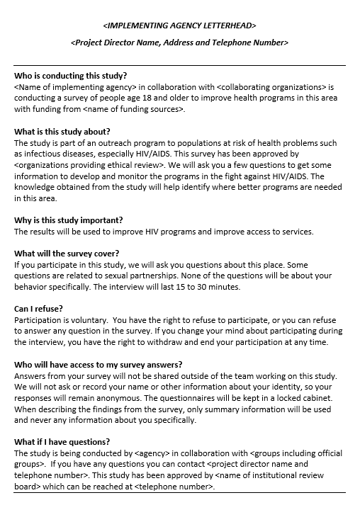
Fact sheet

Slide 15

Activity: Read fact sheet
Read the changed sections of the fact sheet aloud
Interviewers take turns reading the sections “What will the survey cover?” and “Can I refuse?”
Feel free to ask questions about the content of the fact sheet
Notes:
Note: The purpose of this activity is for interviewers to hear sections of the fact sheet revised for Form B read aloud while they read along.
Note: The trainer responds to any doubts the interviews have regarding interpretation.
This fact sheet is mostly the same as the one used in Form A. Two sections are different. Let’s read aloud the sections, “What will the survey cover?” and “Can I refuse?” “What will the survey cover?” is different from the fact sheet given to community informants, because the content of the survey is different. “Can I refuse?” is the same, but let’s read it again to remind ourselves of these important concepts related to the participant’s rights.

Slide 16
Form B:
Venue Informant Interview

Slide 17
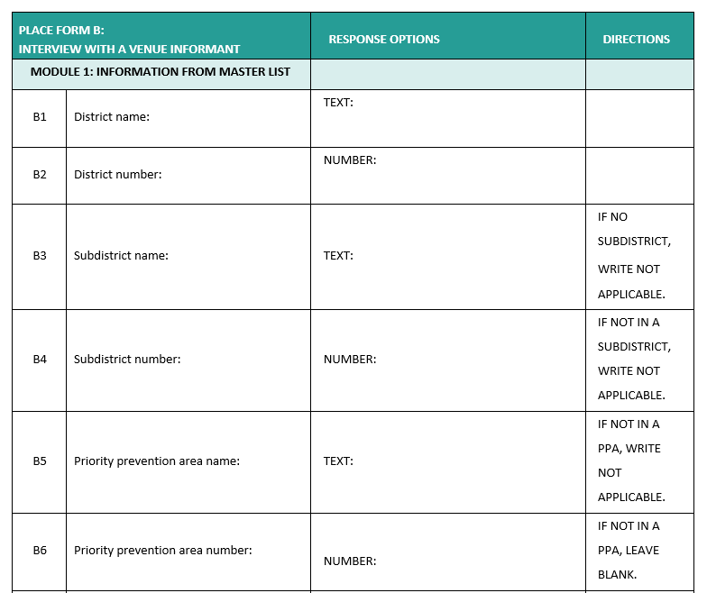
Notes:
Note: Adapt this slide to reflect the version of Form B that will be used for this application of PLACE.

Slide 18
Form B content
Status of venue and confirm venue location and name
Recruitment
Staff at venue
Venue visitors (patrons)
Busy days and times
Other venues nearby
HIV prevention programs on site
Interviewer observations of venue
Mapping
Notes:
Note: Adapt this slide to reflect the content areas of Form B that will be used for this application of PLACE.
Here is a list of the content areas of Form B.
READ SLIDE.

Slide 19
Activity: Read questions
Read Form B aloud
Interviewers take turns reading a question and answer categories
The questions will be explained later in depth
Notes:
Note: The purpose of this activity is for interviewers to hear the questions read aloud while they read along. Taking turns reading a question keeps interviewers engaged. Interviewers must read through all of Form B to become familiar with the content.
Note: Unlike in the Form A training, the trainer will not explain each question at this time. This is because of Form B’s length. Later, when reviewing one section of the form at a time, each question will be discussed further.

Slide 20
Form B content
Status of venue and confirm venue location and name
Recruitment (will review later)
Staff at venue
Venue visitors
Busy days and times
Other venues nearby
HIV prevention programs on site
Interviewer observations of venue
Mapping (will provide instructions later)
1
2
3
Notes:
Note: Adapt this slide to reflect the content areas of Form B that will be used for this application of PLACE.
For training purposes, we divided Form B into three sections. We will go into greater detail about the purpose and intent of each question, and then will practice interviewing that section in pairs before moving on to the next section.

Slide 21
Activity: Read questions in Section 1
Read Section 1 of Form B aloud again
Interviewers take turns reading a question and its answer categories
After each question is read, the trainer describes the type of information sought and answers any questions
Notes:
Note: The purpose of this activity is for interviewers to learn the intent of each question and discuss its answer categories.
Now we will go back to the beginning of Form B and focus on the questions in the first section of the survey.

Slide 22
Section 1: Confirm venue exists
Status of venue:
Does venue exist?
Notes:
Note: This slide is intended to be reviewed in conjunction with the relevant survey question/s. Only slides for questions that may need more explanation are included here.
One of the main things you do when visiting a venue is to find out if the information given by community informants is true. First – does it exist? Some informants name venues that previously existed but are now closed.

Slide 23
Section 1: Venue status options (1)
Venue not found
Venue found and operational
Closed for a week or more, but not permanently
Closed permanently
Duplicate venue
Other
Notes:
Note: This slide is intended to be reviewed in conjunction with the relevant survey question/s. Only slides for questions that may need more explanation are included here.
Options for indicating the status of the venue are:
READ SLIDE
Sometimes the status of the venue is called outcome of the venue visit.

Slide 24
Section 1: Venue status options (2)
Venue not found – Does not exist or not enough information to find it
Venue found and operational – Most venues!
Closed for a week or more, but not permanently – Example: for renovations, for the rainy season. If closed for one day, come back another day.
Closed permanently – No longer in operation
Duplicate venue – Example: You find out an interview was already conducted at the venue under a different name. No need to do another interview.
Other
Notes:
Note: This slide is intended to be reviewed in conjunction with the relevant survey question/s. Only slides for questions that may need more explanation are included here.
In some cases it is not possible to find the venue mentioned by community informants. The venue may not exist or the information about how to find it was not sufficient. Every effort should be made to locate a venue. Ask people in the community near where the venue was reported to be located. If after trying you still cannot find a venue, mark the first option. Very few venues named by community informants should be marked “not found.”
In most cases, the venue will be found and in operation— that is, people visit the venue. Even if a venue is a park or field, if it is still a park or field or a place where people could go to meet sex partners, then it is considered operational.
Sometimes there will be a venue that is closed when you visit. Asking people near the venue may help you find a better time to visit the venue when you can find a respondent. Sometimes a venue is under renovation or the owner has gone away temporarily. If the venue is closed during fieldwork but not permanently, mark “closed for a week or more, but not permanently.” Every effort should be made to return to venues to complete Form B when possible.
Some venues named by community informants no longer exist, they have closed their doors and will not reopen. Mark these “closed permanently.”
During this step of fieldwork, you may find that one venue listed is actually the same as another on the list that has already been visited for an interview. It is not necessary to interview again. Instead, mark “duplicate venue” and indicate which venue it duplicated in the space provided.

Slide 25
Section 1: Correct basic information
Correct name, address, and type given by community informants, if necessary
Notes:
Note: This slide is intended to be reviewed in conjunction with the relevant survey question/s. Only slides for questions that may need more explanation are included here.
Another important purpose of visiting the venue is to correct the information given by community informants. This includes the name, address, and type.

Slide 26
Section 1: Venue visitors
Questions about different people who visit a venue
Including key populations
Notes:
Note: This slide is intended to be reviewed in conjunction with the relevant survey question/s. Only slides for questions that may need more explanation are included here.
Another portion of Form B includes questions about who visits the venue. This can help programs know at which venues they can reach certain populations at risk for HIV, including key populations such as female sex workers, men who have sex with men, transgender people, and people who inject drugs.

Slide 27
Who are men who have sex with men?
Men who have sex with men may self-identify as being gay, homosexual, or bisexual.
For PLACE, we will consider someone a man who has sex with men if he says that he has had anal sex with a man in the past year.
Having anal sex is much riskier in terms of HIV risk than penis-to-vagina sex.
Men who have sex with men are more likely to acquire HIV than other men. They are also less likely to get services.
Notes:
Note: This slide is intended to be reviewed in conjunction with the relevant survey question/s. Only slides for questions that may need more explanation are included here.
Note: This slide was seen in the PLACE overview on the first day of interviewer training. It is included here to make sure interviewers understand the definition of MSM.
Note: If MSM are not a focus of this PLACE study, delete this slide.

Slide 28
Who are transgender people?
Transgender people identify with a different gender than the one they were assigned at birth.
For example, a transgender female was born male but over time felt more like a female than a male. In some cases, transgender people get hormone injections to change their appearance. “Trans” means changed.
A transgender male was born female and became male.
Transgender women are especially at risk for acquiring HIV.
Notes:
Note: This slide is intended to be reviewed in conjunction with the relevant survey question/s. Only slides for questions that may need more explanation are included here.
Note: This slide was seen in the PLACE overview the first day of interviewer training. It is included here to make sure interviewers understand the definition of transgender people.
Note: If transgender people are not a focus of this PLACE study, delete this slide.

Slide 29
Who are people who inject drugs?
Many people get medical injections or vaccinations. These people are not at increased risk of HIV.
PLACE is interested in finding places where programs can reach people who inject drugs, such as heroin, illegally.
People who USE drugs such as marijuana or alcohol can have risky behaviors while under the influence of the drugs but there is an added risk from needles that makes finding injecting drug users very important.
Notes:
Note: This slide is intended to be reviewed in conjunction with the relevant survey question/s. Only slides for questions that may need more explanation are included here.
Note: This slide was seen in the PLACE overview the first day of interviewer training. It is included here to make sure interviewers understand the definition of people who inject drugs.
Note: If PWID are not a focus of this PLACE study, delete this slide.

Slide 30
Who are women who have sex for money and/or goods and services?
Often referred to as female sex workers
Many women find themselves in situations where they will have sex with a man in exchange for money, goods, or favors. In some cultures it is common for women to have multiple partners and accept gifts and favors from them. In some cases these gifts and favors are very important to the survival of the women.
We will focus on obtaining data to improve services for women who have recently exchanged sex for money. These women are generally at highest risk.
Notes:
Note: This slide is intended to be reviewed in conjunction with the relevant survey question/s. Only slides for questions that may need more explanation are included here.
Note: This slide was seen in the PLACE overview the first day of interviewer training. It is included here to make sure interviewers understand the definition of female sex workers.
Note: If female sex workers are not a focus of this PLACE study, delete this slide.

Slide 31
Activity: Practice Section 1
Interviewers form pairs.
One interviewer takes the role of venue informant while the other interviewer conducts Section 1 of the Form B interview.
Reverse roles to give the other interviewer practice.
Questions about this section of the Form B interview?
Notes:
Note: Make sure interviewers have several blank Form Bs to complete during practice. If there is time, interviewers can change partners and practice again.
Note: The purpose of this activity is to give the interviewers a chance to read each question aloud and to fill in Form B with the responses.
Now you will form pairs and practice only that section of Form B with one of you taking the role of general venue informant and the other the interviewer. Afterward, reverse roles so that your partner can practice.
(Once everyone is finished) How did the practice go? Does anyone have any questions?

Slide 32
Activity: Read questions in Section 2
Read Section 2 of Form B aloud again.
Interviewers take turns reading a question and its answer categories.
After each question is read, the trainer describes the type of information sought and answers any questions.
Notes:
Note: The purpose of this activity is for interviewers to learn the intent of each question and discuss its answer categories.
Now we will move on to the second section of Form B and repeat the process. First, let’s take turns reading the questions aloud and discussing them.

Slide 33
Section 2: Busy day and time
Busiest day and time
Next busiest day
Number of men and women there
Number of key populations and other vulnerable groups
Saturday night busy?
Number of female sex workers and men who have sex with men on Saturday night
Notes:
Note: This slide is intended to be reviewed in conjunction with the relevant survey question/s. Only slides for questions that may need more explanation are included here.
Note: If female sex workers and/or men who have sex with men are not a focus of this PLACE study, edit this slide so that it corresponds with Form B.
In Form B we ask about the busy days and times for each venue. This gives information about when the most people will be present at a venue, which can be used to plan outreach for programs and also to plan the next level of PLACE interviews.
There are also questions about the number of men and women, key populations, and other vulnerable groups of people who visit the venue at busy times.
Next there is a question that asks whether Saturday night between 8 and 11 pm is busy. If so, how many female sex workers and men who have sex with men are there on a typical day at that time? We ask this in order to know how many of these people are at venues in the area at one point in time that is likely busy in the community.

Slide 34
Section 2: Other venues
Venue informant names two other venues
Notes:
Note: This slide is intended to be reviewed in conjunction with the relevant survey question/s. Only slides for questions that may need more explanation are included here.
Questions about other venues give us information about venues that community informants may have missed.

Slide 35
Activity: Practice Section 2
Interviewers form pairs.
One interviewer takes the role of venue informant while the other interviewer conducts Section 2 of the Form B interview.
Reverse roles to give the other interviewer practice.
Questions about this section of the Form B interview?
Notes:
Note: Make sure interviewers have several blank Form Bs to complete during practice. If there is time, interviewers can change partners and practice again.
Note: The purpose of this activity is to give the interviewers a chance to read each question aloud and to fill in Form B with the responses.
Now you will form pairs and practice only that section of Form B with one of you taking the role of general venue informant and the other the interviewer. Afterward, reverse roles so that your partner can practice.
(Once everyone is finished,) How did the practice go? Does anyone have any questions?

Slide 36
Activity: Read questions in Section 3
Read Section 3 of Form B aloud again.
Interviewers take turns reading a question and its answer categories.
After each question is read, the trainer describes the type of information sought and answers any questions.
Notes:
Note: This slide is intended to be reviewed in conjunction with the relevant survey question/s. Only slides for questions that may need more explanation are included here.
Note: The purpose of this activity is for interviewers to learn the intent of each question and discuss its answer categories.
Now we will move on to the third section of Form B and repeat the process. First, let’s take turns reading the questions aloud and discussing them.
Instructions for measuring mapping coordinates will come later.

Slide 37
Section 3: HIV prevention on-site
HIV prevention at venue
Supportive of HIV prevention at venue?
Notes:
Note: This slide is intended to be reviewed in conjunction with the relevant survey question/s. Only slides for questions that may need more explanation are included here.
The next section has questions about whether HIV prevention efforts have been carried out at the venue, and if so, how recently. There are questions about the availability of condoms and sexual lubricants, HIV testing, and peer education.
At venues where the informant reports condoms being available at the time of the interview, the interviewer asks to see one and marks whether one was shown to him or her.
At the end of this section, there are questions about whether the informant is supportive of HIV prevention efforts being carried out at the venue. In many cases, the venue informant works there, and so may give a sense of whether this venue is a potential place for programs to do outreach.

Slide 38
Section 3: Observations
Count staff
General description of physical venue (tables? bar? beds? electricity? running water? etc.)
HIV prevention at venue (posters? condoms visible? etc.)
Area around venue (residential? rural? Industrial? etc.)
Measure geographic coordinates
Notes:
Note: This slide is intended to be reviewed in conjunction with the relevant survey question/s. Only slides for questions that may need more explanation are included here.
Interviewers look around the venue to complete the next section on observations. This includes counting the number of male and female staff working at that time, a general description of the venue, and whether there is evidence of HIV prevention at the venue.
Next, the interviewer goes outside to observe the area around the venue.
Finally, the venue is mapped by measuring geographic coordinates: latitude and longitude. You will be trained on how this is done later.

Slide 39
Activity: Practice Section 3
Interviewers form pairs.
One interviewer takes the role of venue informant while the other interviewer conducts Section 3 of the Form B interview.
Reverse roles to give the other interviewer practice.
Questions about this section of the Form B interview?
Notes:
Note: Make sure interviewers have several blank Form Bs to complete during practice. If there is time, interviewers can change partners and practice again.
Note: The purpose of this activity is to give the interviewers a chance to read each question aloud and to fill in Form B with the responses.
Now you will form pairs and practice only that section of Form B with one of you taking the role of general venue informant and the other the interviewer. Afterward, reverse roles so that your partner can practice.
(Once everyone is finished) How did the practice go? Does anyone have any questions?

Slide 40
Putting It All Together
Notes:
Now that we have reviewed the fact sheet and Form B, let’s put them together as one set of steps.

Slide 41
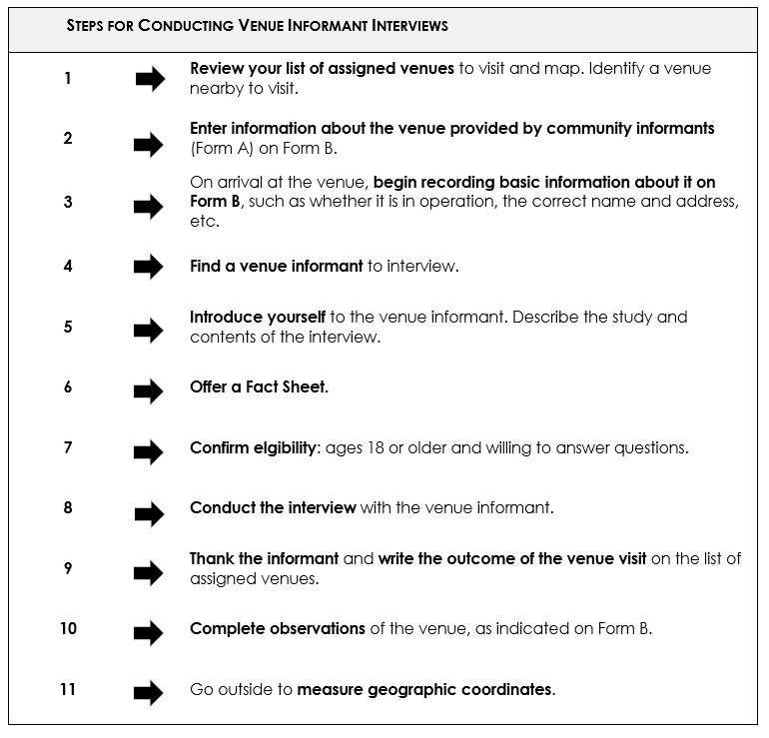
Steps

Slide 42

Observe: Role-play
Interviewers observe recruitment of a venue informant and interview using Form B.
Questions about recruitment process or interview?
Notes:
Note: This role-play consists of two PLACE team members (e.g., Fieldwork Supervisors) conducting the recruitment and interview portion of Form B. Interviewers watch the role-play but do not participate. This is meant to be a good example of an interviewer recruiting a general venue informant and carrying out the interview.
Note: After the role-play, ask if the interviewers have any questions.

Slide 43
Activity: Practice
Interviewers form pairs.
One interviewer takes the role of venue informant while the interviewer recruits him/her and conducts the Form B interview.
Reverse roles to give the other interviewer practice.
Change partners and begin the process again.
Each interviewer practices with two different people.
Notes:
Note: Make sure interviewers have two blank Form Bs to complete during practice.
Note: The purpose of this activity is to give the interviewers a chance to practice the recruitment of an informant, including pointing out the key points of the fact sheet. This is another chance to practice completing Form B.

Slide 44

Discussion
How were the interviews?
Any questions about steps?
Any doubts about questions or answer categories?
Any other questions?
Notes:
Note: This provides another opportunity for interviewers to express any doubts they have about the form or the process.

Slide 45
Tablet Training:
Overview of tablets
Form B on tablets
Mapping with tablets
Practice in pairs
Notes:
Note: This slide is here to indicate it is time to change to the slides for training interviewers in using tablets for data collection. Because instructions must vary with the equipment available, the Fieldwork Supervisor should create these slides.
If this application of PLACE uses paper, replace tablet training with slides for training interviewers on using GPS devices for measuring mapping coordinates of venues. Again, the Fieldwork Supervisor should create these slides, so the instructions will be appropriate to the devices available.
Note: These slides should include an overview of how to use tablets (turn off and on; how to advance screens; rules and responsibilities), Form B on tablets (how response options appear; skips), and mapping with tablets. Then, interviewers practice in pairs using tablets to administer Form B, including mapping.

Slide 46
Activity: Practice outside
Interviewers practice at two venues in the nearby community
Outside the training venue; preassigned venues
Return here immediately after each pair visits four venues
Notes:
Note: Make sure interviewers have the tablets with Form B loaded or two blank paper Form Bs to complete during practice.
Note: The purpose of this activity is to give the interviewers a chance to practice the entire process of recruiting and interviewing general venue informants in the immediate vicinity of the training venue. Afterward, the group will discuss the process prior to going into the field for more practice. Supervisors and trainers accompany the interviewers outside.
Note: It is important to organize this activity in advance by identifying venues prior to the activity. It is suggested that interviewers do two interviews each, but if there is not a sufficient number of venues nearby, then practice one time or find two informants in each venue to be interviewed separately. (There will be more practice later.)
We have practiced Form B interviews a few times now, but always with someone else on the PLACE team who knows the questions. Now we will practice with people in the community who are not familiar with the PLACE method. This is also a chance to complete observations in a site that is new to you. Each interviewer will recruit and interview two venue informants. Because interviewers work in pairs, this means each pair will visit four venues: two for one interviewer and two for another. We will give each pair a list of four venues and directions to arrive at the sites.

Slide 47
Discussion
How was recruitment?
How were the interviews?
Were there any difficulties?
Questions about steps?
Any other questions?
Notes:
Note: This provides an opportunity for interviewers to share their first experiences with venue informant interviews. Trainers can help problem-solve, give tips, and respond to doubts.

Slide 48
Things to avoid
Some venue owners may be suspicious. They may refuse to participate if they do not understand.
    Emphasize that you work with health programs and are not connected with the police or drug agencies.
    Reassure the person that the information is confidential and that information about individual venues will not be shared publicly,

Slide 49
Form B for each venue – no matter what!
If someone is not willing or too young to participate, look for another informant.
  If necessary, look for a knowledgeable informant outside the venue
If no informants can be found, still complete Form B.

Slide 50
Interviewer role-play
Two interviewers volunteer to role-play recruitment and interview.
Discuss strengths and weaknesses of role-play.
Notes:
Note: This activity provides an opportunity for interviewers to critique recruitment and interview as carried out by a fellow interviewer. You may have interviewers do this more than once in different pairs.

Slide 51
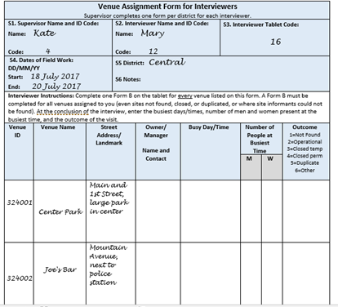
Venue assignment form (1)
Assigned venues
Notes:
Note: Replace the example venues assignment form (found in the Fieldwork Implementation Guide) with the version adapted for the local context.
Before going into the field in an area, Fieldwork Supervisors will give each interviewer a venue assignment form. The supervisor will complete all the portions you see filled in here: Supervisor name and ID code, interviewer name and ID, tablet number, start date of fieldwork, and name of district or PPA. There will also be a list of venues, including the venue ID, name, and address. All of this information comes from the Master Venue List created from community informant interviews. Note that this example shows only two venues, but in the field you will be assigned more than that at one time.

Slide 52
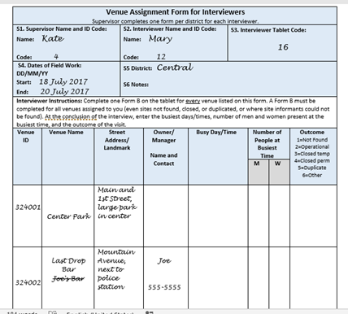
Venue assignment form (2)
Record information during visit
Notes:
Note: Replace example venues assignment form with the version adapted for the local context.
After the venue informant interview, ask for the name of a manager or owner and a phone number. The supervisor may use this information to contact this person to arrange a time to return for Level 3 interviews.
Also correct any information about the venue name or address here. In this example, what community informants call Joe’s Bar is really called Last Drop Bar, but the manager is Joe, which is probably why that was an alternative name.

Slide 53
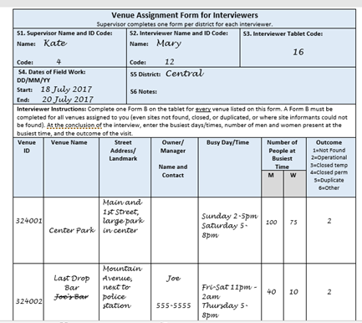
Venue assignment form (3)
Supervisor fills in other blanks based on Form B
Notes:
Note: Replace example venues assignment form with the version adapted for the local context.
When the supervisor reviews the completed Form Bs, he or she will fill in the rest of the information regarding busy days and times, number of men and women, and outcome of the visit.

Slide 54
Activity: Practice fieldwork
Go to the field.
Look at list of assigned venues.
Complete Form B.
Stay with your partner at all times.
Notes:
Note: The purpose of this activity is to give the interviewers a chance to practice the entire process of recruiting and interviewing general venue informants in a setting that is similar to fieldwork. Supervisors and trainers accompany the interviewers to the field. Trainers can provide a list of 4 venues for each pair of interviewers (2 each interviewer). This activity must be planned in advance to identify venues near each other in order to reduce travel time between venues.
Now we will practice in a setting that is like what you will experience during fieldwork. As in fieldwork, you and another interviewer will work as partners so that you always visit venues together. This is best practice for safety in the field.
After 8 interviews, contact the Fieldwork Supervisor or trainer who is with you. (Give him or her your completed forms if using paper.)
Note: The Fieldwork Supervisor or trainer who receives the completed forms must verify that the interviewer put his/her name on Form Bs if using paper. The Fieldwork Supervisors will review the forms and provide feedback to the interviewers.

Slide 55

Feedback
Supervisors and trainers review completed forms for quality with each interviewer.
Provide feedback to each interviewer.
Provide feedback to the group to share what was learned in reviewing forms.
Notes:
Note: One copy of the Form B Quality Checklist (available in the PLACE Tool Kit online) is needed for each Fieldwork Supervisor or trainer reviewing completed forms.
Now the Fieldwork Supervisors and other trainers will review the forms you completed in the field. They will be looking to make sure that the form was filled in correctly and, if using paper forms, that they can read what is written. They will call you up one pair at a time to review your forms. Please wait patiently until this process is completed.
Note: For the review, a Fieldwork Supervisor or trainer sits beside a pair of interviewers and looks at the completed forms. Use the Form B Quality Checklist to guide the review process. Feedback should cover aspects of the work the interviewers need to improve, as well as what they did well. After all forms are reviewed, tell the group what was observed in the completed forms. Pointing out the errors of some interviewers (without naming names) can help others avoid the same errors.

Slide 56
PLACE fieldwork
Level 1: Community informant interviews
Level 2: Venue informant interviews and mapping
Level 3: Patron and worker interviews and HIV testing
Notes:
Remember that after we collect information about venues characteristics and map the venues, we will begin Level 3 interviews, where we return to some of those venues to interview workers and men and women there. We want to go there at a busy time, which is why we ask about that in the Level 2 interviews. In Level 3, you will be joined by a team of HIV testers and counselors who will perform that part of the protocol.

Slide 57
Notes:
Note: Replace the images of Form A with the version that will be used in this application of PLACE.
Form A is also called the Community Informant Report since it is where the interviewer records the information about each venue the community informant reports.
Fill out one form for each venue. So, if an informant names 9 venues, fill out 9 Form As.

